Slide 1
Hormone-Microbiome Interactions and Reproductive Health Outcomes in African Women
PhD Proposal
Supervisor:
Co-Supervisor:

Slide 2
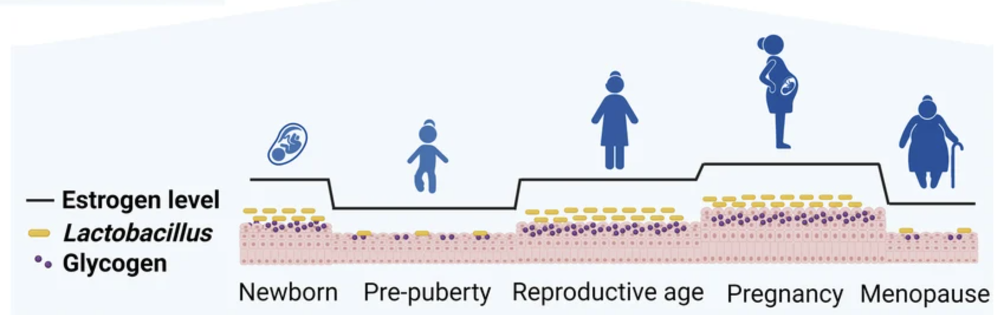
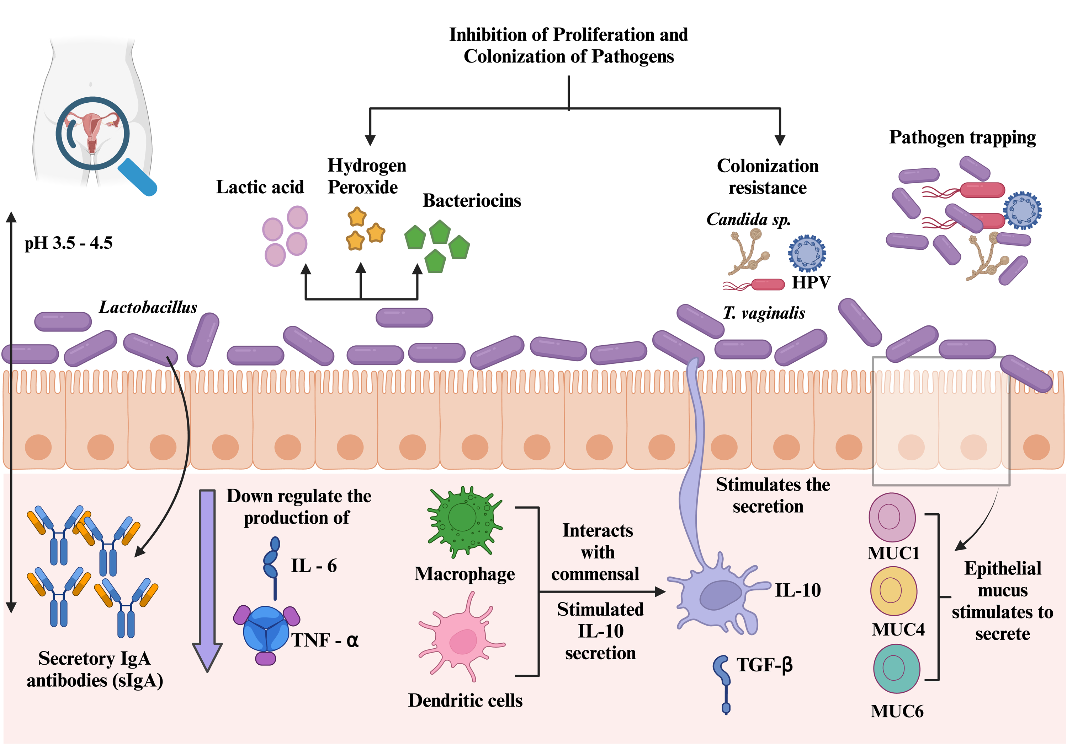
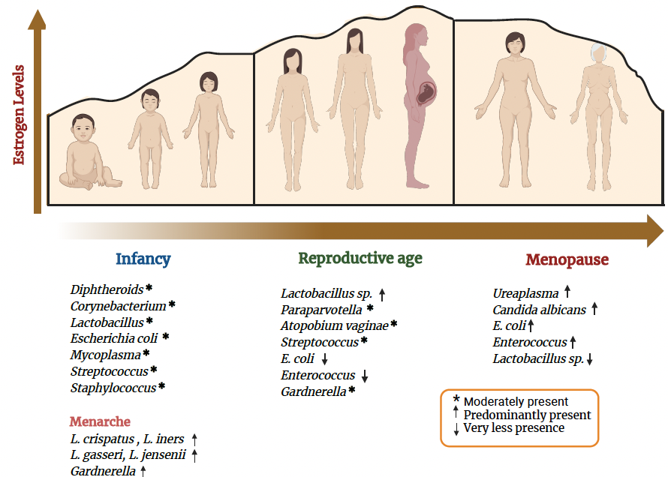
Vaginal Eubiotic Microbiome
The vaginal microbiome is a complex ecosystem that plays a crucial role in women's reproductive health.

Slide 3
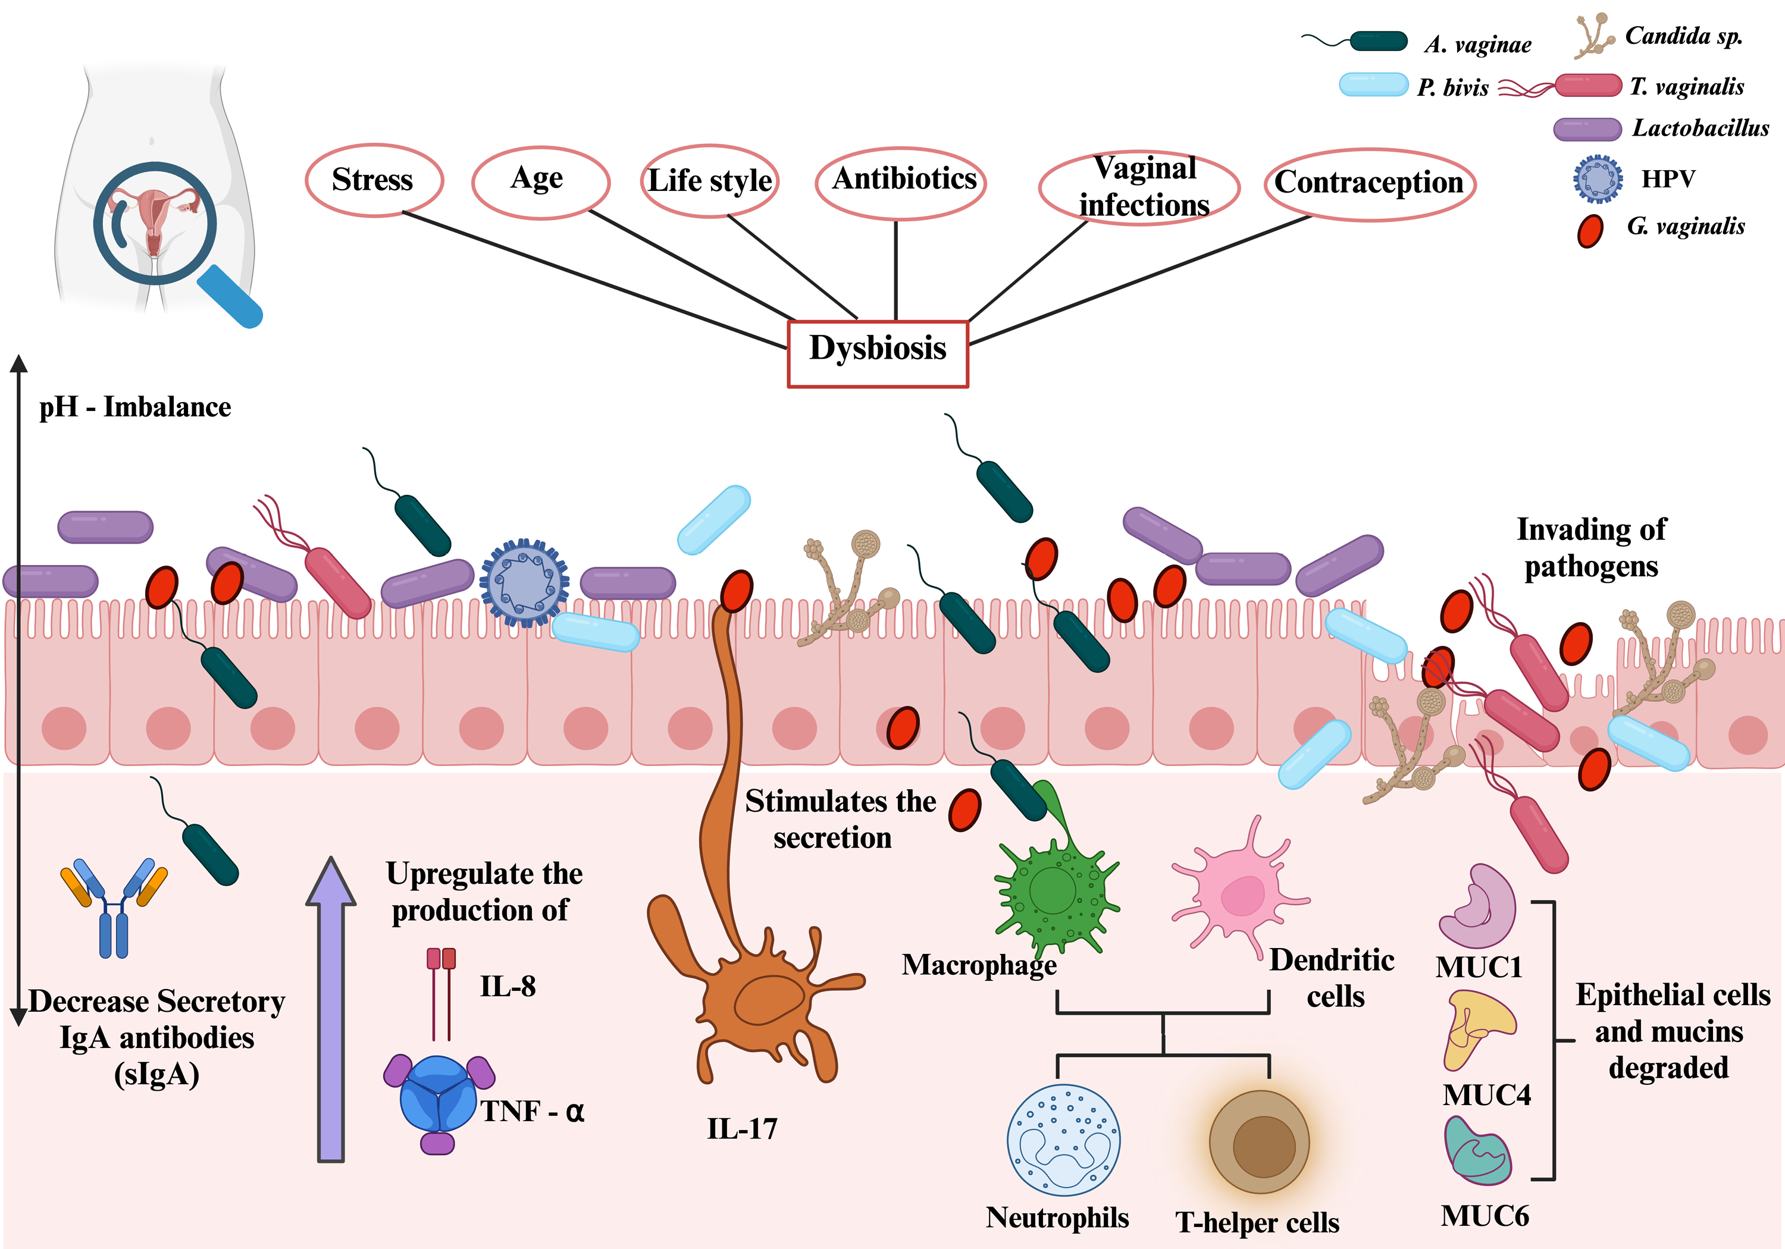
Vaginal Microbiota Dysbiosis
BV: common, non-sexually transmitted condition caused by an overgrowth of harmful anaerobic bacteria, and a decrease in good bacteria

Slide 4
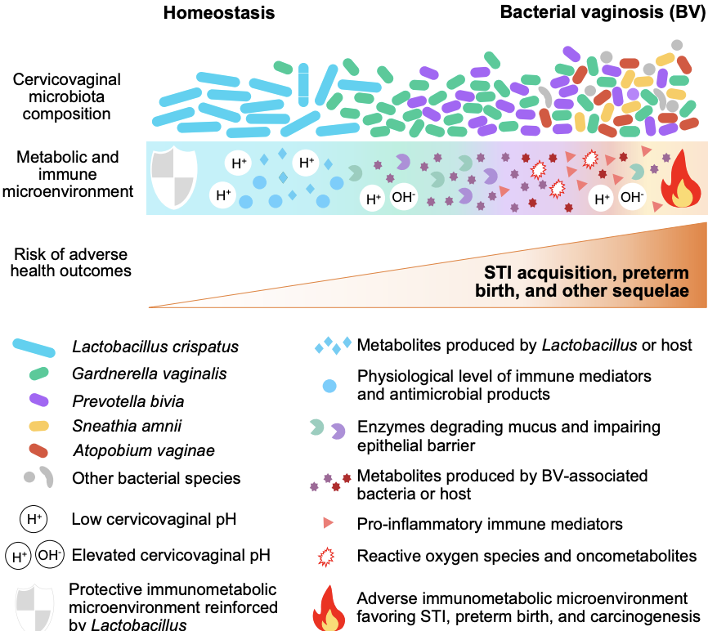
Dysbiotic Vaginal Microbiota-Metabolome
Metabolite Group | Compounds | Adverse impact
Organic Acids (Short-chains & Organic fatty acids) | High: Succinate, Acetate, Malonate | Disrupt vaginal epithelial barrier Toxic to the local host cells Recruit inflammatory cells, and actively
Biogenic Amines | High: Putrescine, Cadaverine, Tyramine | Malodour Fishy ordor
The vaginal metabolome undergoes a profound shift during BV

Slide 5
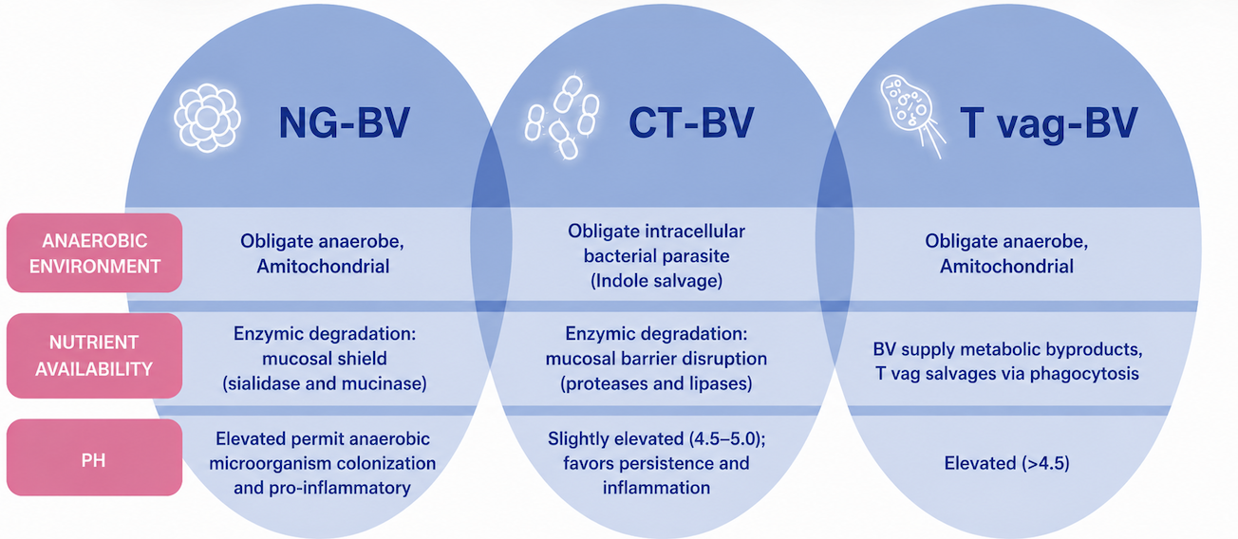
BV-STI coinfection

Slide 6
Study rationale
The vaginal microbiome is central to reproductive health, yet African women remain underrepresented in microbiome studies, limiting region-specific interpretation
Vaginal dysbiosis is linked to BV, STIs, high-risk HPV, inflammation, and adverse pregnancy outcomes
Hormonal changes during pregnancy and postpartum may disrupt microbiome stability and affect recovery trajectories
Exogenous progestins such as DMPA may alter genital tract mucosal endpoints, although findings across studies remain mixed
Integrating hormone, microbiome, cytokine, and infection data may reveal biomarkers relevant to reproductive health in African women

Slide 7
Aims
Aim 1
To characterize longitudinal hormone dynamics during pregnancy and postpartum period, and to determine the association with vaginal microbiome composition stability and pregnancy outcome
Objective
To longitudinally quantify reproductive hormone concentrations, including oestrogen (E2), progesterone (P4), medroxyprogesterone acetate (MPA), and norethisterone enanthate (NET‑EN), during pregnancy and postpartum period
To determine how reproductive hormone profiles influence vaginal microbiome composition and their relationship with pregnancy outcomes
Hypothesis
Longitudinal fluctuations in reproductive hormones influence vaginal microbiome composition and stability, contributing to differential pregnancy outcomes

Slide 8
Aims
Aim 2
To determine how vaginal microbiome composition and dominance states influence genital infection burden (BV and STIs), high-risk HPV detection, and mucosal inflammatory responses among young South African women.
Objective
Characterize vaginal microbiome composition across groups stratified by baseline infection status: no BV/STI, BV only, STI only, and BV-STI coinfection.
Determine associations between vaginal microbiome states and infection burden levels (no infection, single infection, BV-STI coinfection), with nested analyses for high-risk HPV.
Assess whether Lactobacillus-dominant vs. non-Lactobacillus-dominant vaginal microbiome states are linked to differences in genital inflammatory cytokine profiles, independent of clinical infection status, using stratified group comparisons and multivariable models.
Hypothesis
Vaginal microbiome dysbiosis increases progressively across infection states, with the greatest disruption observed in BV-STI coinfection.

Slide 9
Aims
Aim 3
To compare vaginal microbiome composition and genital cytokine profiles amongst women from different African countries and determine relationship between specific microbial taxa and genital cytokine profiles
Objective
To characterize vaginal microbiome composition and cytokine milieu amongst women from different African countries
To determine the association between vaginal microbiome composition specific bacterial taxa, and genital cytokine profiles.
Hypothesis
Vaginal microbiome composition differs across African populations and is associated with distinct cytokine profiles, with non-Lactobacillus dominant communities associated with increased genital inflammation

Slide 10
Study Schema
Study Type | Ancillary prospective observational study
Study population and setting | FRESH Baby U! Cohort, 083 Cohort, and African vaginal samples Women aged 18-27 years
Sample Size | FRESH Baby U! Cohort: 2800 083 Cohort: 243 African vaginal samples: undetermined
Intervention | Serial measurement of hormones, microbiome, cytokines, and infection status during pregnancy and postpartum
Primary outcome | Vaginal microbiome composition, hormone profiles, cytokine levels, BV/STI/HPV burden
Secondary outcome | Microbiome stability, postpartum recovery, and associations with pregnancy outcomes including preterm birth
Sample type | Cervicovaginal fluid, Vaginal swabs, Serum

Slide 11
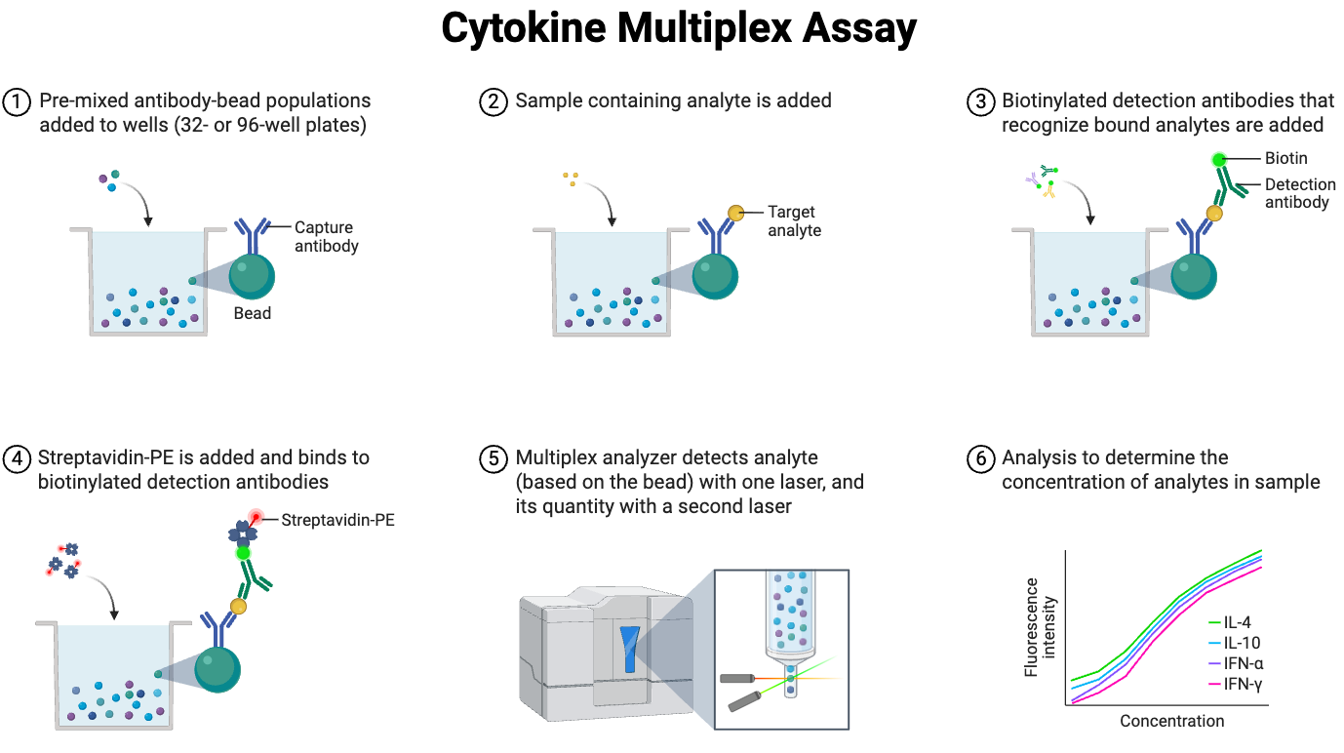
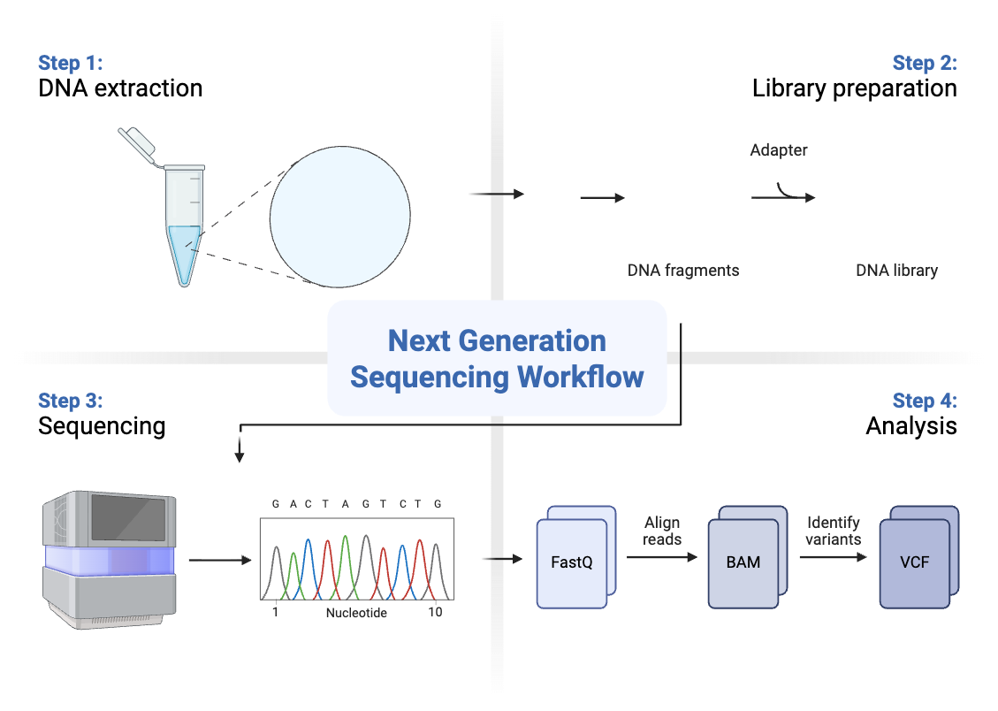
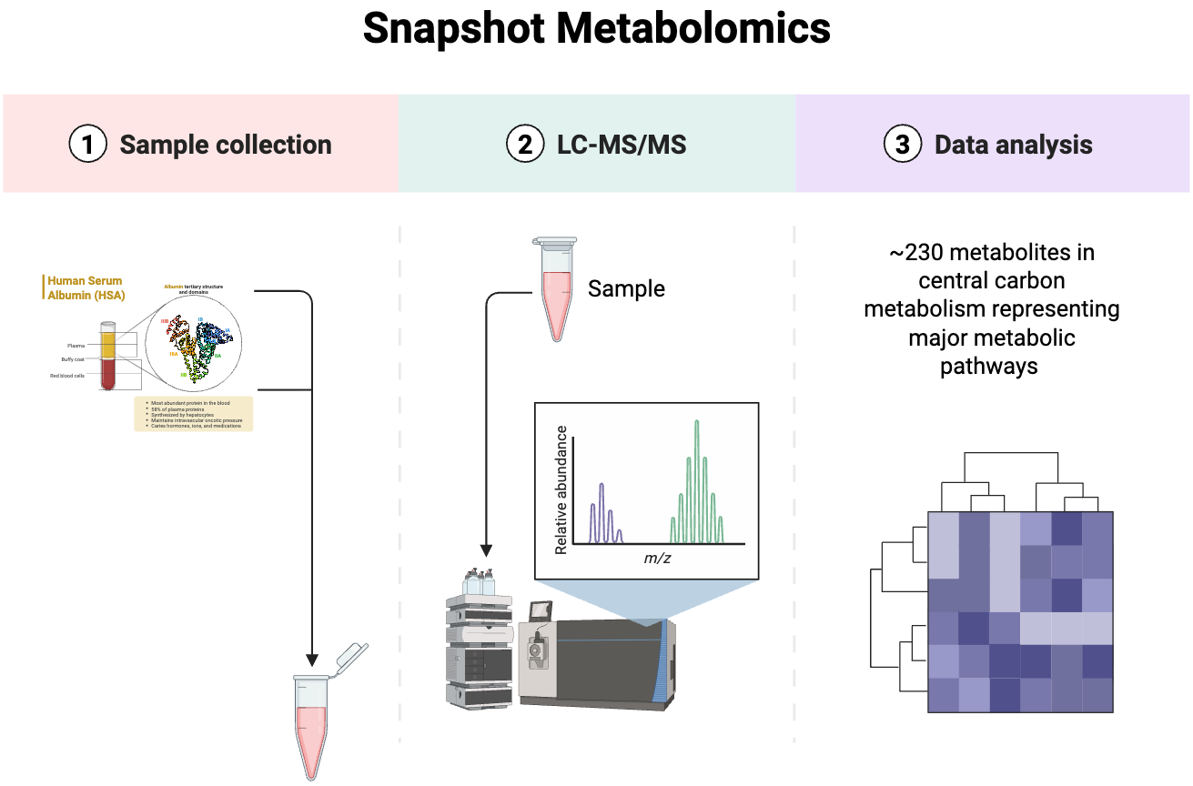
Methodology
Soft cup supernatant
Vaginal Swab
16s rRNA

Slide 12
Stats
Aim 1: Repeated-measures analysis of longitudinal hormone data across pregnancy and postpartum
Aim 2: Group comparisons of vaginal microbiome diversity and dominance states across BV/STI categories
Aim 3: Correlation and multivariable modeling of 16S rRNA microbiome profiles with cytokine levels in women of reproductive age
Covariates: age, gestational stage, contraceptive exposure, infection status, and postpartum timepoint
Microbiome analyses: alpha diversity, beta diversity, and differential abundance
Cytokine and microbiome associations: correlation analysis with multiple-testing correction
Aim 3 sample size: exploratory, based on available specimens

Slide 13
Thank You

Slide 14
Methodology
Study design
This will be an ancillary prospective observational cohort study nested within the existing FRESH Baby U! platform, 083 Cohort, and African vaginal samples.
Study population and sampling
Inclusion criteria
Materials and methods
Hormone quantification (Leverage on vag microbiome data): LM-MS/MS
Cytokine and host response profiling in women: Luminex
African vaginal microbiome characterization and cytokine profiling : 16s rRNA and Luminex
Vaginal microbiome composition and dominance states influence genital infection burden: (Leverage 083 data) Bioinformatics and stats

